Slide 1

Welcome to Indonesia! “Discover Indonesia”

Slide 2
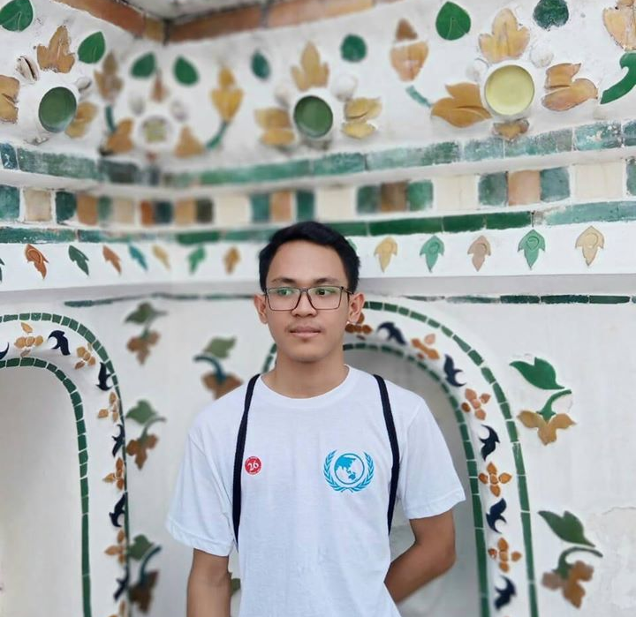
About me!
I am Dicky Aditiya Kurniawan (21), currently studying Business Management at Sepuluh Nopember Institute of Technology, Indonesia.

Slide 3
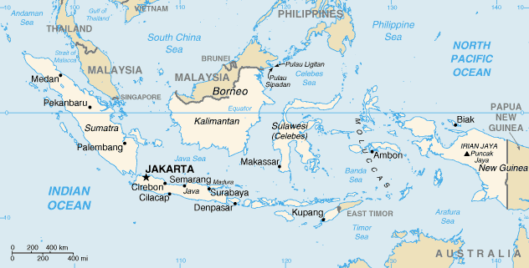

Slide 4
Fascinating Facts About Indonesia
Indonesia consists of more than 17,000 islands, ranging from Sabang (the westernmost part) to Merauke (the easternmost part).
Indonesia has more than 700 different languages and dialects.
Indonesia is home to over 100 endangered animals.
Notes:
1. 6000 islands are inhabited.

Slide 5
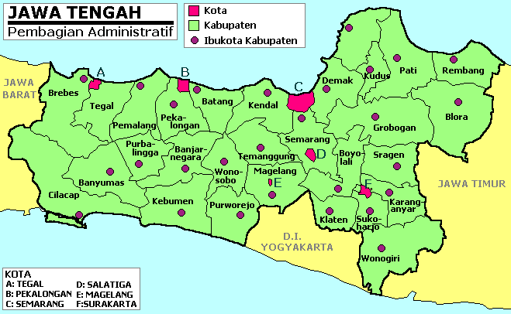
Central Java!

Slide 6
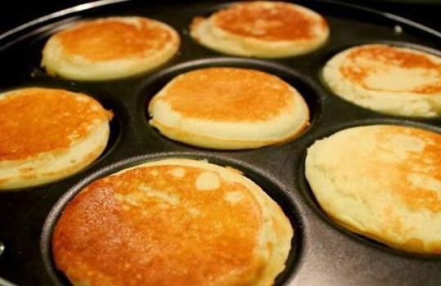
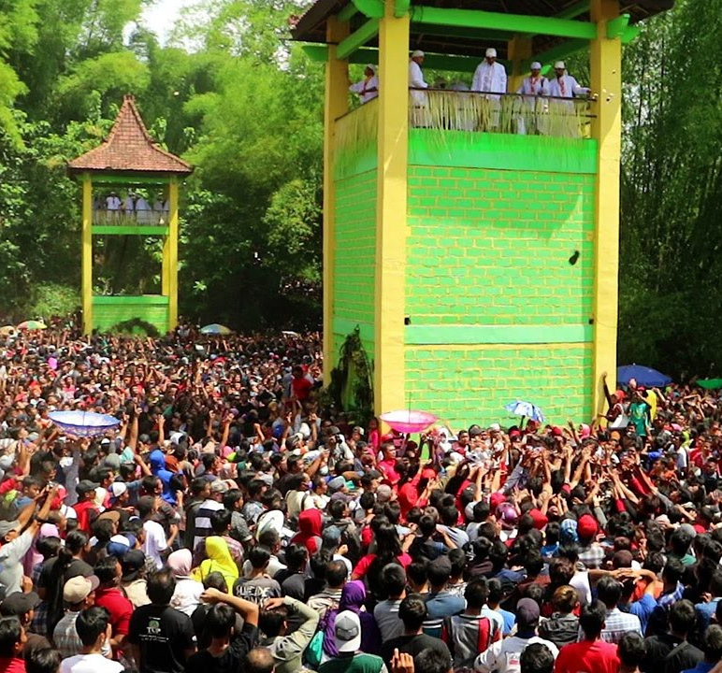
Sebaran Apem Yaqowiyu
The Traditions in Klaten
The purpose of the ritual is to remember the great merit of Ki Ageng Gribig, one of the missionaries of Islam in Jatinom Klaten during the reign of the “Sultan Agung Hanyokrokusumo”. Yaqowiyu ritual uniqueness lies in deployment “apem” in peak ceremony, which is around cake made of rice flour with coconut pieces in the middle.

Slide 7
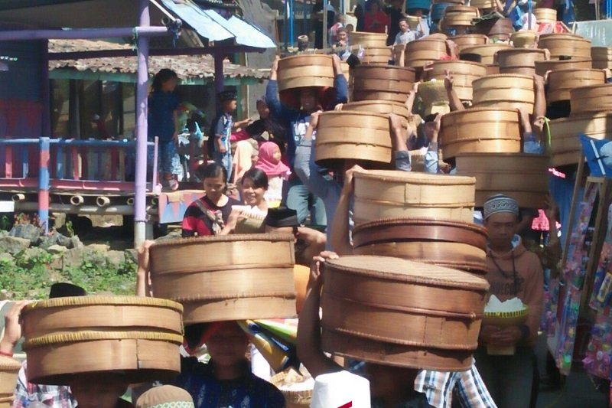
Sadranan or “Nyadran”
The tradition also includes cleaning graveyards and sending prayers to ancestors during the months of Ruwah in the Javanese calendar.

Slide 8
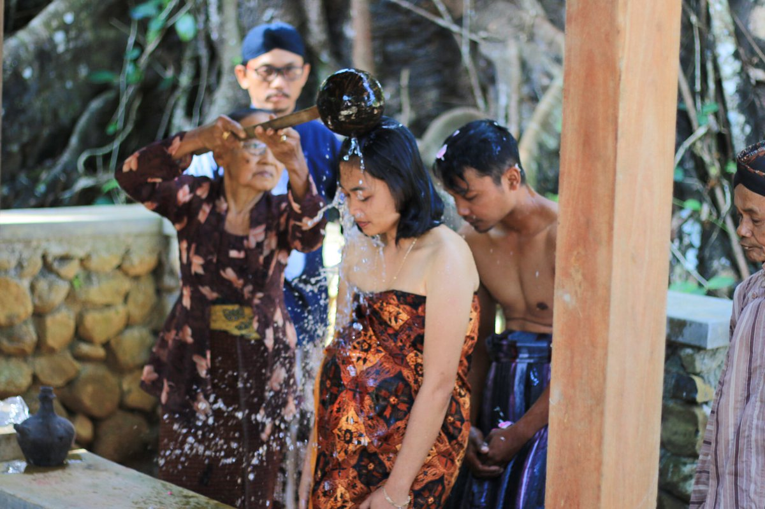
Mitoni Ceremony: A Ritual for Seven Months of Pregnancy
The Javanese believe that a seven-month-old infant has got a soul, whose security should be celebrated. And the first child is said to bring good luck to the family and other siblings. Like other traditional ceremonies, Mitoni is practiced in different fashions in different regionalities, as the saying goes - so many places, so many customs.

Slide 9
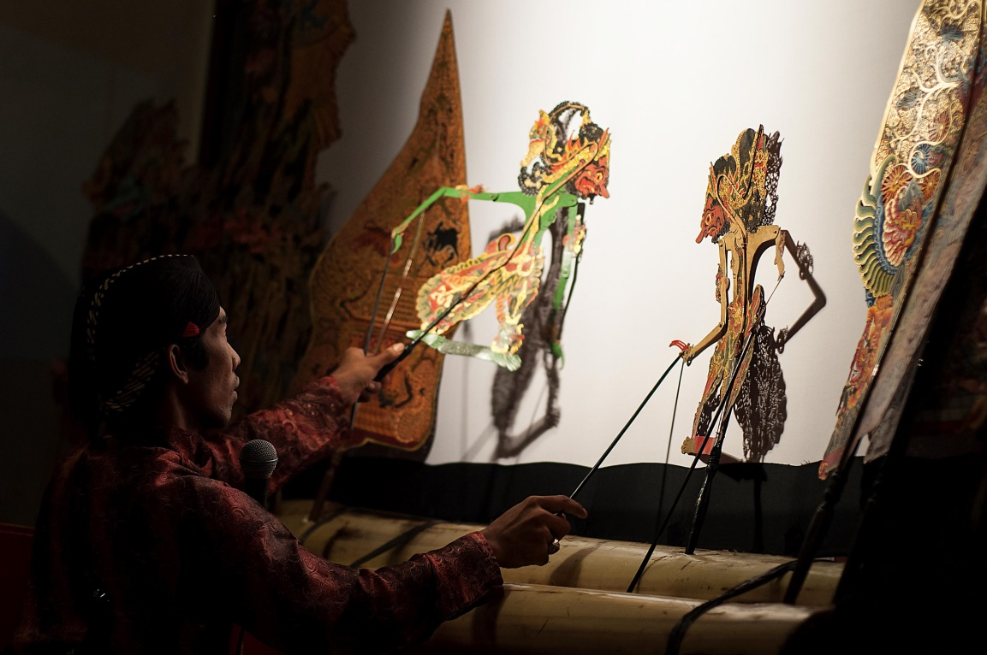
Wayang Kulit (Leather Puppet) Show
This performance art has been more than five centuries of age. Presenting the story of Ramayana and Mahabharata, this overnight performance serves the proper space to spend the night, reflect and understand Javanese life philosophy.

Slide 10
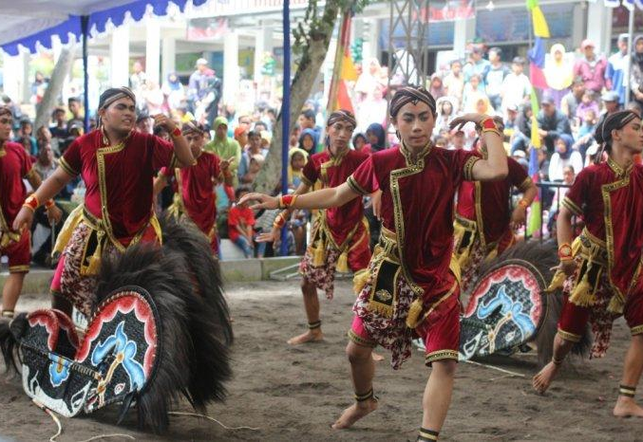
Jathilan Horse Dance
Jathilan is one of the names for traditional Javanese trance dance which takes its roots in the most archaic levels of local culture but remains very popular nowadays. It is also described as a horse dance for the horse effigies made of woven bamboo are the hallmark props used by the performers. Horse dance is a part of the folk culture, still untouched by institutionalization or commodification; it can be performed for both ritual and entertainment purposes.

Slide 11
Terima Kasih!
Muito Obrigado!

